Slide 1
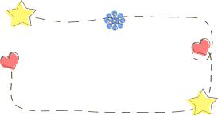

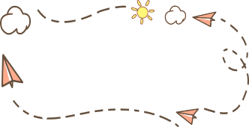



PET IMAGE SEGMENTATION
by Mennatallah Ramadan

Slide 2
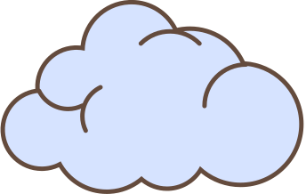
PROJECT OVERVIEW
Task: Semantic image segmentation on the Oxford-IIIT Pet Dataset
Goal: Accurately segment pets from their backgrounds
Architecture: U-Net - a specialized convolutional network for biomedical image segmentation
Framework: TensorFlow/Keras

Slide 3
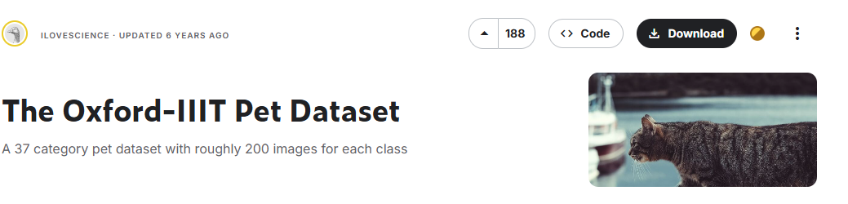
THE DATASET
Oxford-IIIT Pet Dataset
Contains 7,349 images of cats and dogs
A 37 category pet
Includes pixel-level segmentation masks
Three classes: pet, background, and outline

Slide 4

DATA PROCESSING PIPELINE
Loading: TensorFlow Datasets API
Preprocessing:
Resizing images to 128×128
Normalization (pixel values to 0-1 range)
Zero-based indexing for segmentation masks
Data Augmentation:
Random horizontal flipping
Batching: 64 images per batch with prefetching

Slide 5
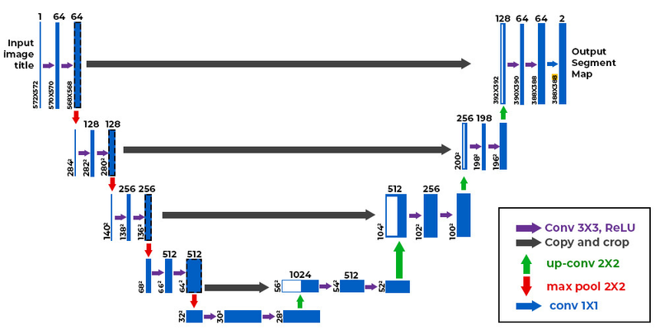
U-NET ARCHITECTURE
Encoder Path: 4 downsampling blocks with increasing filters (64→1024)
Decoder Path: 4 upsampling blocks with decreasing filters (512→64)
Skip Connections: Preserve spatial information
Dropout Layers: Prevent overfitting (30% rate)
Output: 3-channel softmax activation (pet, background, outline)

Slide 6

MODEL DETAILS
Parameters
~34 million
Loss Function
Sparse Categorical Crossentropy
Optimizer
Adam
Metrics
Accuracy
Training
20 epochs

Slide 7
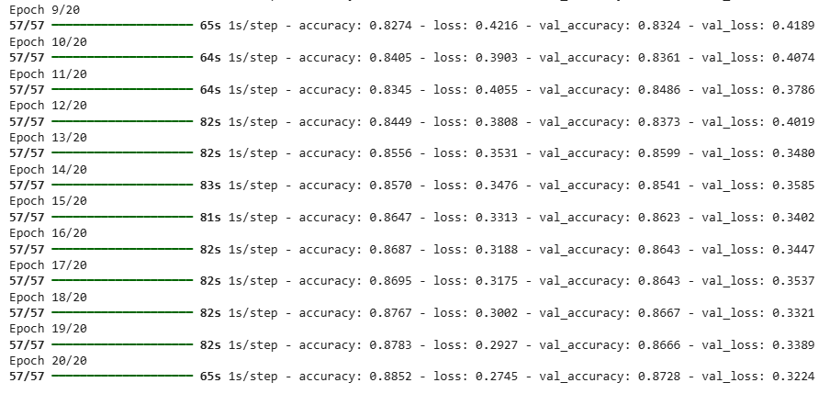
TRAINING RESULTS

Slide 8

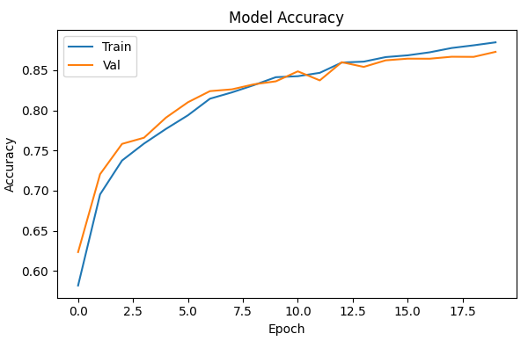
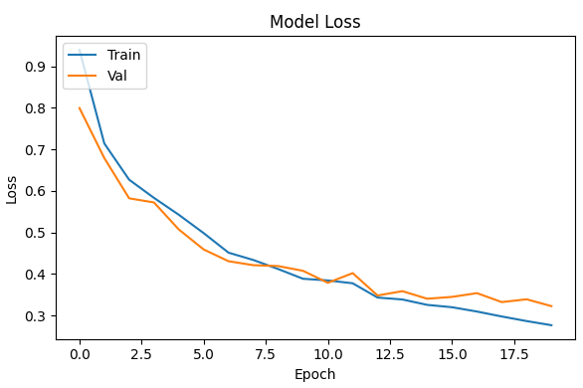
VISUALIZE RESULTS

Slide 9
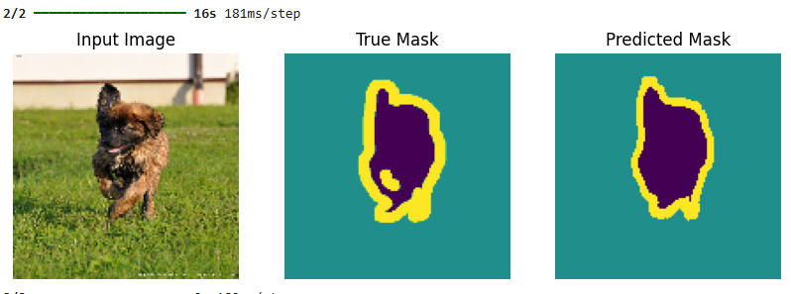
TEST PREDICTIONS

Slide 10
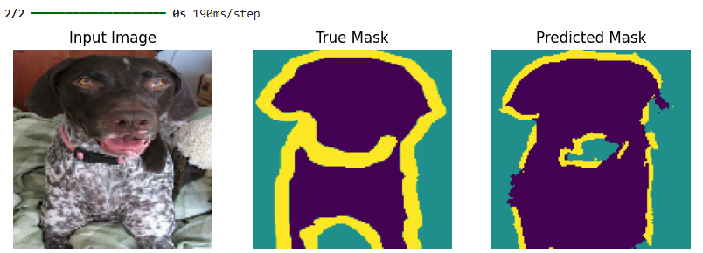
TEST PREDICTIONS

Slide 11

THANK YOU

